Slide 1

ELECTRIC VEHICLE EXPLORATORY DATA ANALYSIS

Slide 2
BUSINESS OBJECTIVE
AtliQ Motors is an automotive giant from the USA specializing in electric vehicles (EV)
The chief of AtliQ Motors India wanted to do a detailed market study of existing EV/Hybrid market in India before proceeding further.
Hence it is decided to perform Exploratory Data Analysis (EDA) from fiscal years 2022 to 2024

Slide 3
PROBLEM STATEMENT
Identifying EV makers sales performance over the fiscal years.
Analyzing the penetration rates of EVs in different states.
Examining quarterly sales trends for leading 4-wheeler EV manufacturers.
Identifying peak and low season months for EV sales to assist in strategic planning
Projecting future EV sales in key states for 2030 based on historical growth rates.

Slide 4
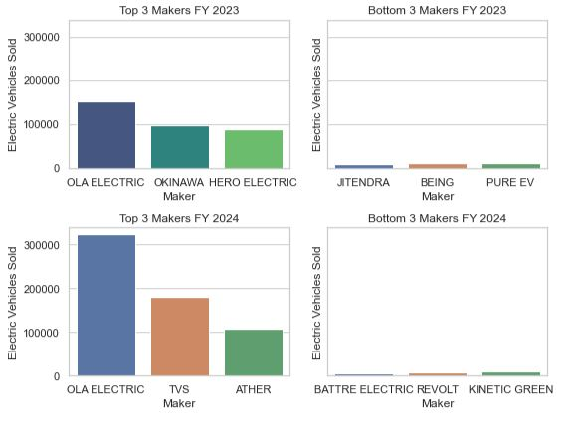
Top And Bottom 3 2 Wheeler Makers For The Year 2023 And 2024

Slide 5
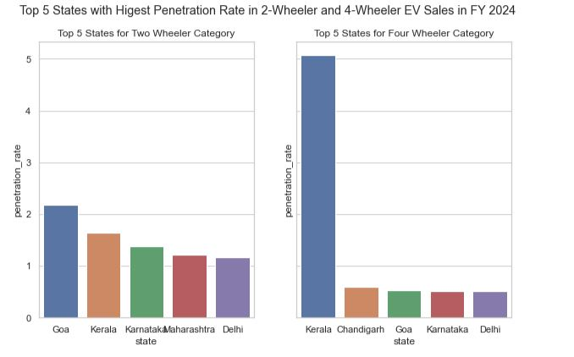
Top 5 States with Highest Penetration Rate in EV Sales FY 2024

Slide 6
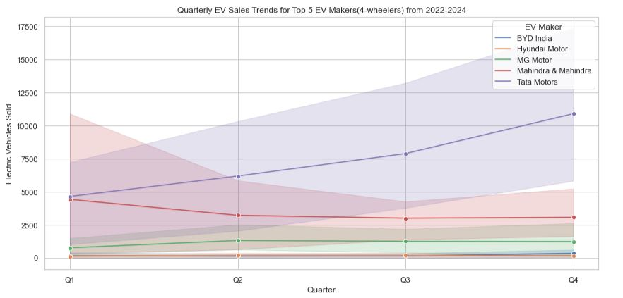
Quarterly Trends for Top 5 EV makers from 2022 to 2024

Slide 7
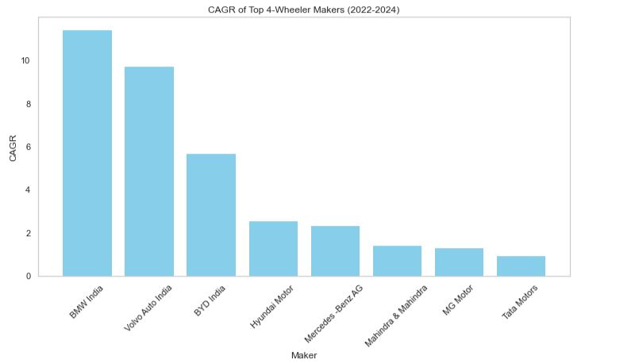
Compounded annual growth rate (CAGR) in 4-Wheeler for Top makers

Slide 8
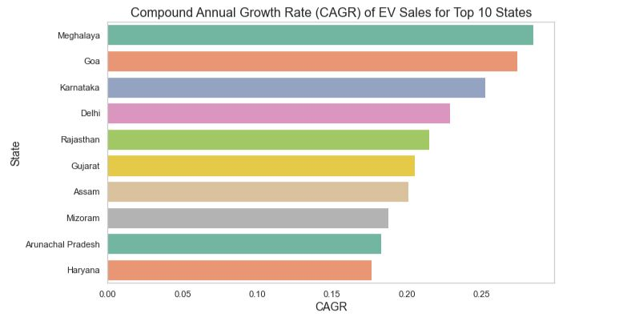
Top 10 States with highest CAGR from 2022 to 2024 in total vehicles sold

Slide 9
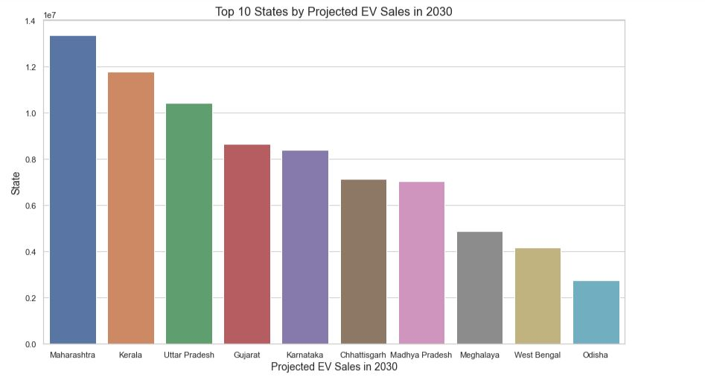
Projected Sales growth for FY 2030 for Top 10 States

Slide 10
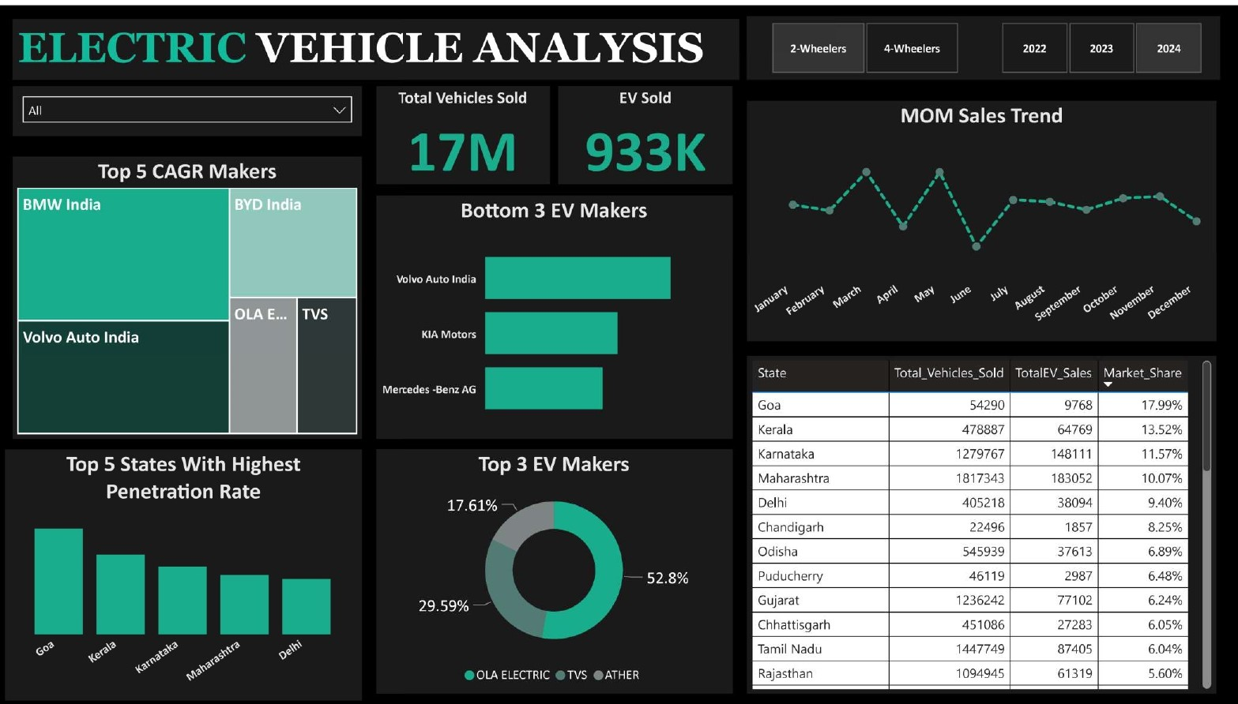
Electric vehicle analysis dashboard

Slide 11
FEATURES OF THE DASHBOARD
Penetration rate – Bar chart shows the top 5 states with highest
penetration rate.
Top 3 EV makers – Pie bar chart shows the top 3 EV makers from the year 2022 to 2024
Bottom 3 EV makers – Horizontal bar chart shows the bottom 3 EV
makers from the year 2022 to 2024
Top 5 CAGR makers – Tree map shows the CAGR of top 5 EV makers
KPI Table – A pivot table shows the various KPI across different states.

Slide 12
BUSINESS OUTCOMES
BMW India has a higher CAGR compared to Tata motors, despite Tata Motors showing lower CAGR figures and varying quarterly sales trends.
Meghalaya , Goa and Karnataka exhibit highest CAGR in total vehicles sold, indicating significant market expansion and substantial investment opportunities in these states.
Maharashtra, Kerala and Uttar Pradesh are projected to see the highest CAGR by 2030.

Slide 13
Thank you
Gopal Varma
Senior Executive
gopalvarma0897@gmail.com
8888416729

